Slide 1
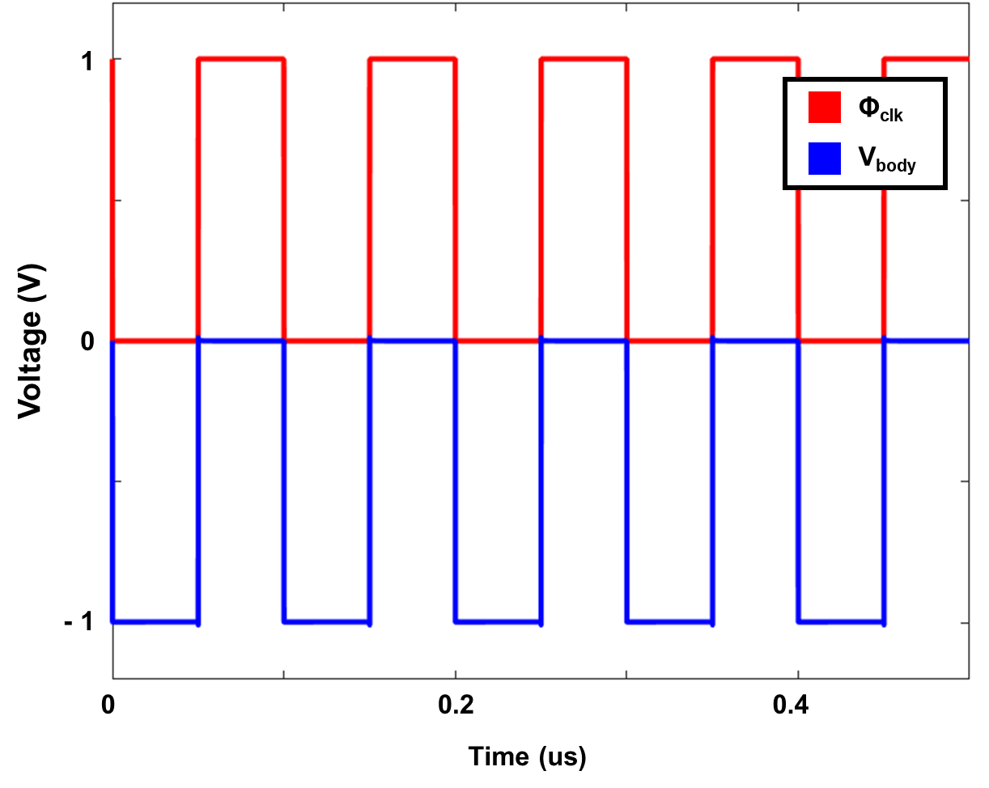
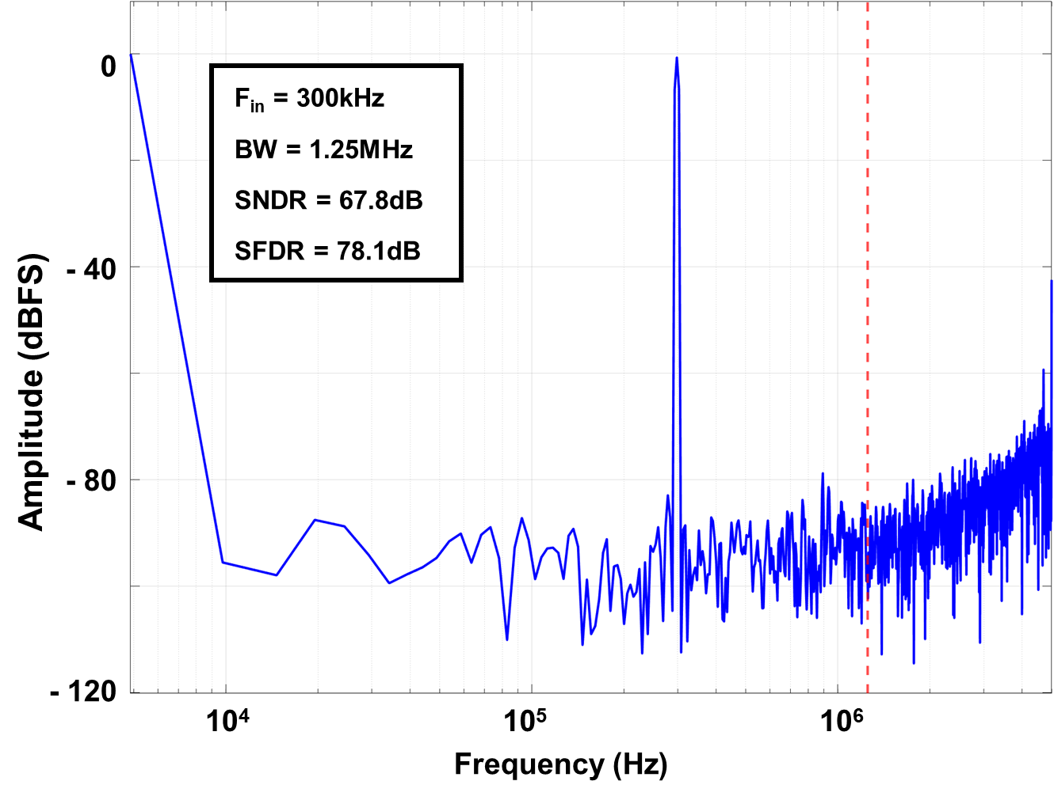
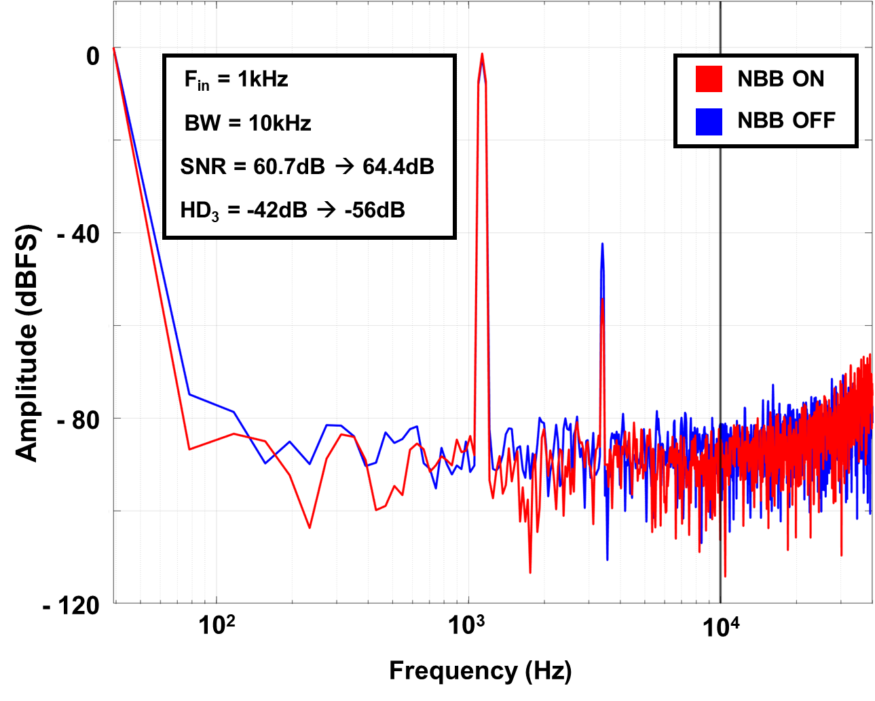
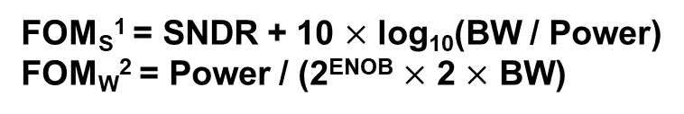
Sub-threshold Leakage Reduced Noise-Shaping SAR ADC
Gichan Yun, Kyeongwon Jeong and Minkyu Je
School of Electrical Engineering, Korea Advanced Institute of Science and Technology (KAIST)
E-mail: ygc980215@kaist.ac.kr
Introduction
Designed NS SAR ADC is based on ping-pong mechanism which has merit in no additional timing slot for integration.
Asynchronous monotonic switching scheme is applied in the SAR ADC.
Negative body biasing (NBB) is applied to every switches of the passive integrator.
Body bias is changed to -1V when the switch is off, while it returns to 0V when the switch is on.
Successive approximation register (SAR) analog to digital converter (ADC) has been an attractive candidate for various applications for its power and area efficiency. SAR ADC can obtain moderate resolution with high bit quantizer, while noise shaping (NS) techniques are implanted to achieve higher resolution. It can be implemented by adding an active integrator or passive integrator with additional gain stages.
V_{res}(z)
V_{res}(z)
A
V_{int}(z)
Φ_{clkb}
C_{boost}
V_{int}(z)
Φ_{clk}
V_{body}
Active integrator
Passive integrator
Φ_{clkb}
Motivation
Φ_{clkb}
I_{Tunneling}
Schematic of NBB circuit
[JSSC 2020, M. –J. Seo]
NBB transient response
n+
I_{sub-threshold}
n+
Simulation Results
I_{Junction}
I_{Junction}
p-substrate
Leakage current in MOS
Integrator in SAR ADC is mostly based on switched capacitor techniques.
Leakage current such as sub-threshold leakage and gate leakage can affect the stored voltage in the integration capacitor.
Leakage current effects is getting worse when the length of the process is shorter, and the operating frequency is low.
Sub-threshold leakage current can be suppressed by adjusting the body bias to negative which results higher threshold voltage.
High threshold voltage can degrade the speed of the switch which can disturb the settling behavior of the switched capacitor integrator.
Dynamic body biasing should be implanted to satisfy both characteristics.
Circuit Implementation
FFT plot with 10MS/s operation
FFT plot with 80kS/s operation
Designed NS SAR ADC achieved SNDR of 67.6dB and SFDR of 78.1dB when operating in 10MS/s.
If the sampling frequency is 80kS/s which is quite slow, the SFDR degrades to 36dB. SFDR is improved by 14dB when the NBB technique is implanted. SNR is also improved by 3.7dB.
V_{ref}
9
V_{inp}
Φ1 ↔ Φ2
SAR
LOGIC
9
D_{out}
Parameter | Value | Parameter | Value
Process | 65nm | SNDR | 67.8dB
Fs | 10MHz | SFDR | 78.1dB
OSR | 4 | FOM_{S}¹ | 170.32dB
Power | 70.0uW | FOM_{W}² | 13.96fJ/Conv step.
V_{inn}
Φ1 ↔ Φ2
V_{ref}
9
FOM_{S}¹ = SNDR + 10 $×$ log₁₀(BW / Power)
FOM_{W}² = Power / (2^{ENOB} $×$ 2 $×$ BW)
Block diagram of NS SAR ADC [ISSCC 2019, Y. -Z. Lin]
Performance Summary
Summary & Conclusion
In low frequency operating SAR ADC, leakage current can be a serious problem which interrupts the operation of the switched capacitor based integrators.
Negative body biasing which is operated dynamically can efficiently lower the effects of the sub-threshold leakage when the switch is off.
The proposed IC can improve both SNR and SFDR which can estimate the non-idealities of the ADC.
The proposed technique can be further used in the applications that the sub-threshold leakage is significant.
Acknowledgement
The chip fabrication and EDA tool were supported by the IC Design Education Center (IDEC), Korea.

